Slide 1
FRAUD ANALYTICS
Rajabhishek Aditya
Darshan H.R
Arpit Namdeo
Natarajan senguttuvan
Praveen Mahendiran

Slide 2
INTRODUCTION
For health insurance companies , identifying the records of patients from hospitals to check the genuinity of the claim is a tremendous task.
Insurance fraud occurs when any act is committed with the intent to fraudulently obtain some benefit or advantage to which they are not otherwise entitled or someone knowingly denies some benefit that is due and to which someone is entitled.
According to a recent survey by insurance institute of India, it is estimated that the number of false claims in the Indian industry is approximately 15 per cent of total claims
The same report suggests that the healthcare industry in India is losing approximately Rs.600-Rs 800 crores incurred on fraudulent claims annually.

Slide 3
OBJECTIVE
Frauds are unethical and are losses to the company. By building a model that can classify auto insurance fraud
The goal of this project is to build a model that can detect health insurance fraud.
The challenge behind fraud detection in machine learning is that frauds are far less common as compared to legit insurance claims.

Slide 4
Types of Frauds under Insurance Sector
Claim fraud: Fraud against the Insurance Companies in the purchase and/or execution of an insurance product, including fraud at the time of making a claim.
Application Fraud: Here, the customer despite being aware of all factual information related to his pre-existing diseases, conditions, DOB, claims, etc enters the wrong information.
Eligibility Fraud: This also denotes fraudulence by providing false information. For example, providing the wrong employment status of the employee in order to gain eligibility to a health policy with extra benefits
Medical Identity Theft: Here, a policyholder’s name is being wrongly used without the consent or knowledge of the person to access free medical services or treatments
External and internal frauds: Simply put, external fraud refers to fraudulence made either by the customer, service provider or beneficiaries against the insurance company. Whereas internal fraud is made by agents or insurance companies against the customer.

Slide 5
HEALTH INSURANCE FRAUD EXAMPLES
Treatment of uninsured persons, but billing for insured persons covered in the health policies.
Billing for Doctor Fees for his unnecessary visits to the patients in the Hospital.
Billing for services not rendered.
Unwarranted procedures, excessive investigations, expensive medicines.
The extended length of stay keeping in view the high sum insured in the policy.
Documents submitted are of doubtful nature.
Claims for disease or injury which seems to be pre-existing.
Collecting treatment cost from the innocent patients with misrepresentation that all amounts will not be admissible in an insurance policy.
Filing claims for treatments that are not medically necessary.
Intermediary takes the premium but does not pass it to the Insurance Company.

Slide 6
PREVENTION OF FRAUD IN HEALTH INSURANCE
Carefully read your health insurance policy’s terms and conditions
Carefully fill in the application and enter all requested details honestly and correctly.
Immediately get in touch with the insurance company if you suspect fraud.
Ensure to thoroughly read all ‘add-on’ benefits that you are entitled to.
Identification of Hospitals committing frauds.
Identification of Intermediaries indulged in fraudulent activities.
Compliance with the procedure of KYC for premium and settlement of claims.
Beware of “free” offers
Closely review all your medical bills

Slide 7
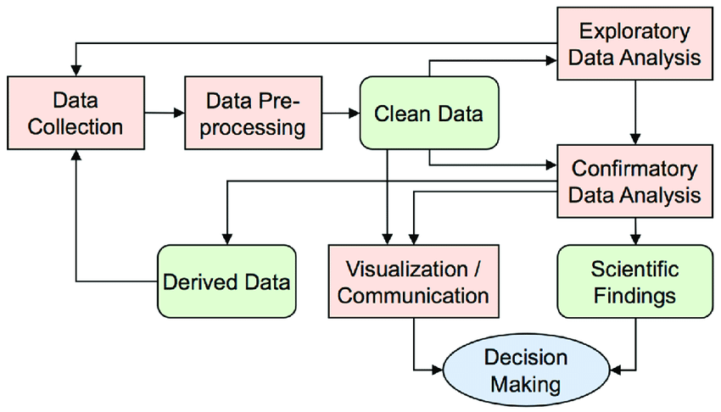
FLOW CHART FOR THE SOLVING PROBLEM USING OF DATA SCIENCE

Slide 8
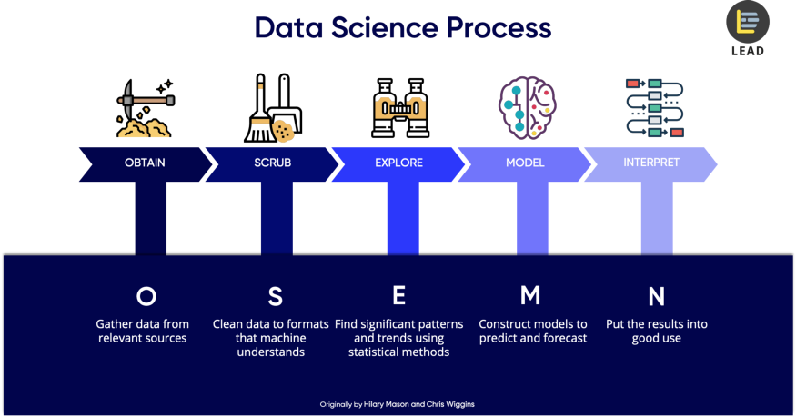
PROJECT ARCHITECTURE/FLOW
DAY 1
DAY 2
WEEK 1
WEEK 2-3
WEEK 4

Slide 9
Process Flowchart (Road Map)
EDA | Model selection | Model Building & Tuning | Deployment
1. Basic understanding of data. 2. Data cleaning (Missing & duplicate values treatment). 3. Data Visualizations (using Excel & Python) 4. Label Encoding & Feature selection | 1. Approach to Imbalance dataset. (Test & Train) 2. Over sampling (RandomOverSampler & Smote) 3. Selection of best model based on Mean % score, Bias & Variance (Logistic Regression, KNeighborsClassifier,DecisionTreeClassifier, XGBClassifier, BaggingClassifier, AdaBoostClassifier, RandomForestClassifier, gradientBoostingClassifier) 4. Model Score ('Train Score accuracy', 'Test Score accuracy', 'Recall Score', 'Precision Score’, 'F1-Score’) (Selecting Top Models by Trial-error on values like test_size, sampling_strategy, criterion & few etc.) | 1. Model Building (RandomForestClassifier[RFC1]) 2. Hyper parameter tuning (Selecting best parameters) 2(II). RFC2 = RandomForestClassifier(n_estimators=50,max_features=6,min_samples_leaf=6,min_samples_split=5,n_jobs=-1) 3. Outcome: RFC stands best. | 1. Tuned Model score. 2. Confusion Matrix. 3. Roc Curve. 4. Deployment

Slide 10
Data Set Description
Introduction to Datasets
There are 24 variables in our data in which 23 are independent variables and 1 is dependent variable.
Total columns and rows (records)
- Total Columns = 24 ,Total records = 1048575

Slide 11
Description of Variables :
0-Areas of service :
There are 7 areas of services where data on hospital facilities are collected
1-Hospital County :
There are certain counties in each area where the hospital services are provided
2-Hospital Id :
In each county, there are various types of hospitals with different Id numbers
3-Age :
There are patients of different age groups starting from 0 to 70 years and older. This includes newborn baby as well
4-Gender: Male/ Female
5-Cultural Group :
Different Cultural Groups like
Black are called as African Americans.
White who are white American
Other Race – Groups other than the above two

Slide 12
6-Ethnicity :
Spanish/Hispanic: Spanish speaking countries especially people from Central and South America
Non-Spanish: Main English speaking countries called Anglo Americans
7-No. of Days Spent in Hospital:
The average length of stay in hospitals (ALOS) is often used as an indicator of efficiency. All other things being equal, a shorter stay will reduce the cost per discharge and shift care from inpatient to less expensive post-acute settings. The ALOS refers to the average number of days that patients spend in the hospital. It is generally measured by dividing the total number of days stayed by all inpatients during a year by the number of admissions or discharges. Day cases are excluded. The indicator is presented both for all acute care cases and for childbirth without complications.

Slide 13
8-Admission Type :
8-Admission Type :
Code | Code value
1 | Emergency: The patient requires immediate medical intervention as a result of severe, life-threatening, or potentially disabling conditions. Generally, the patient is admitted through the emergency room.
2 | Urgent: The patient requires immediate attention for the care and treatment of a physical or mental disorder. Generally, the patient is admitted to the first available and suitable accommodation.
3 | Elective: The patient’s condition permits adequate time to schedule the availability of suitable accommodation.
4 | Newborn: The patient is a newborn delivered either inside the admitting hospital (UB04 FL 15 value 5 [A baby born inside the admitting hospital] or outside of the hospital (UB04 FL 15 value “6” [A baby born outside the admitting hospital]).
5 | Trauma: The patient visits a trauma center (A trauma center means a facility licensed or designated by the State or local government authority authorized to do so, or as verified by the American College of surgeons and involving a trauma activation.)

Slide 14
9-Home or Self Care, 10-ccs diagnosis code, 11-ccs procedure code, and 12-APR-DRG ( All Patient Refined Diagnosis Related Groups are related to each other according to CCS(Clinical Classification Software) guideline attached.
Type of recommended care is covered under Home or Self-care
ccs diagnosis code is the code depending on the type of disease
ccs procedure code is the code for the recommended clinical procedures to be followed.
Apr-drg description is the description of the disease

Slide 15
13-Illness Code :
0 -for stage unspecified
1 -for mild
2 -for moderate
3 -for severe
4 -for indeterminate
14-Mortality Risk :
1 -for Minor
2 -for Moderate
3 -for Major
4 -for Severe

Slide 16
15-Surge_ Description – Type of Treatment – May be Surgical or Medical.
16-Weight_baby : Wherever the admission type is “New Born”, there will be some baby weight, otherwise it is 0.
17-Aburtion (Y/N)
Wherever, there is a “newborn” as type of admission, there is “N” for abortion. In all other cases it is “Y”
18-Emergency_Deptt:
An emergency department, also known as an accident & emergency department, emergency room, emergency ward or casualty department, is a medical treatment facility specializing in emergency medicine, the acute care of patients who present without prior appointment; either by their own means or by that of an ambulance.
The patient admission type may or may not be emergency, but during treatment, the case can be taken to emergency deptt.

Slide 17
19-Total Charges
Think of a hospital as a hotel. A hotel has a price list and charges you for the room, internet service, food and beverages. It includes medical procedures, lab tests, supplies, medications etc. A hospital charges for every item used by a patient along with its associated charges (billed charges) on every claim submitted to an insurance carrier or patient.
20-Total Costs
Hospital costs vary according to how much they must spend to provide patient care, as opposed to how much a patient or insurer must spend to receive care. The hospital earns a surplus when they receive higher amounts than their costs. They incur a loss when the opposite occurs.

Slide 18
21-Cost–to-Charge Ratios & Their Relevance
Hospitals typically compare their total charges to their cost using a cost-to-charge ratio determination.
The cost-to-charge ratio is the ratio between a hospital’s expenses and what they charge. The closer the cost-to-charge ratio is to 1, the less difference there is between the actual costs incurred and the hospital’s charges. Multiplying each hospital’s overall cost-to-charge ratio by total charges provides an estimate of the hospital’s costs.
The cost-to-charge ratio can be used to estimate the cost of some specific procedures or to compare hospital costs between different facilities in the same local area or in other areas of the country.
22- Result :
1 - Genuine Claim
0 - Fraud Claim
23. Payment Typology :
Method of Payment in insurance claim
5 categories of payment typologies are defined below:
Medicare
Medicaid
Other Governments
Department of Corrections
Private Health Insurance

Slide 19
1.3 Exploratory Data Analysis
Exploratory Data Analysis (EDA) is an approach to analyzing data sets to summarize their main characteristics. In the given data set there are 24 variables and data types of all variables are either float64 or int64 or object. There are 1048574 observations and 24 columns in our data set. Missing value is also present in our data.

Slide 20
Steps in Data Exploration
Identification of variables and data types
Analyzing the basic metrics
Graphical Univariate Analysis
Bivariate Analysis
Variable transformations
Missing value treatment

Slide 21
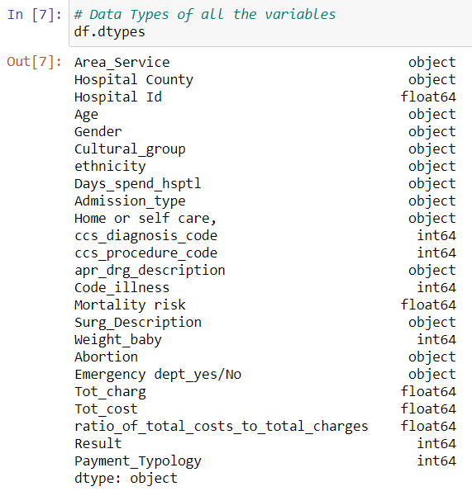
Identification of variables and data types
Insight-
In the given data set there are 24 variables and data types of all variables are either float64 or int64 or object.
dtypes: float64(5), int64(6), object(13)

Slide 22
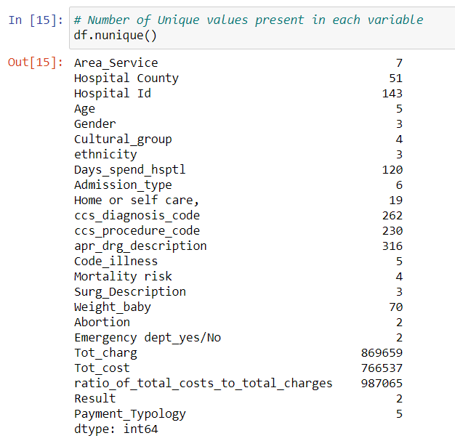
Insights-
From this data we can says that nuique command gives non repeating values for each attributes .

Slide 23
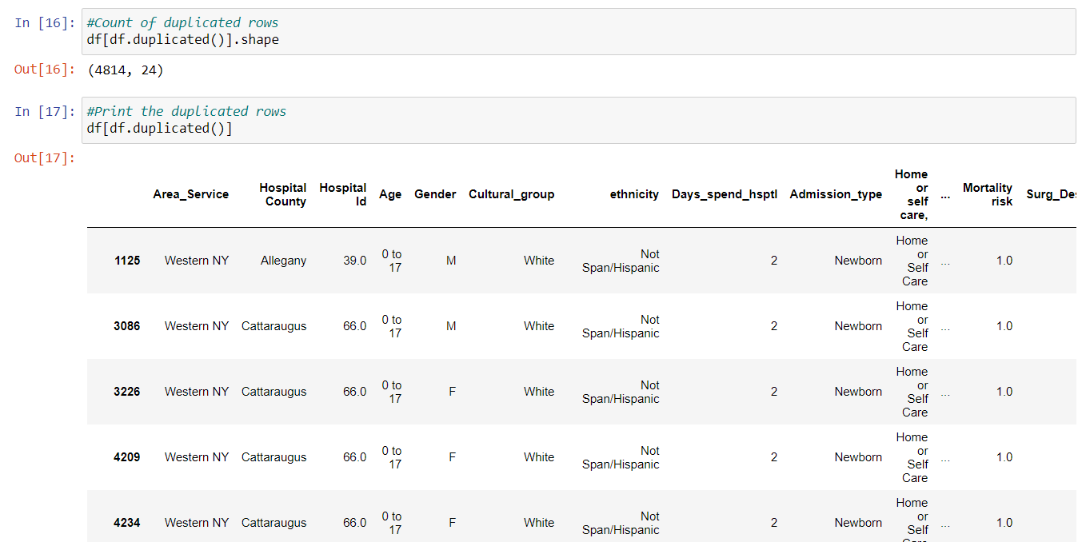
Analyzing the basic metrics
Insights-
We are counting the duplicate rows so we have got 4814 duplicate rows

Slide 24
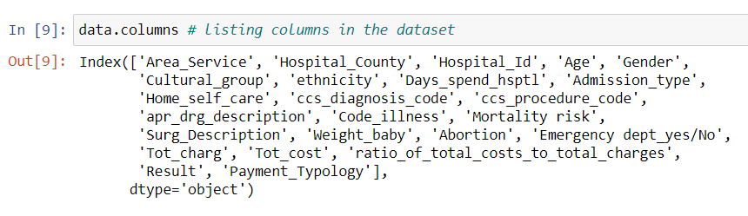

Slide 25
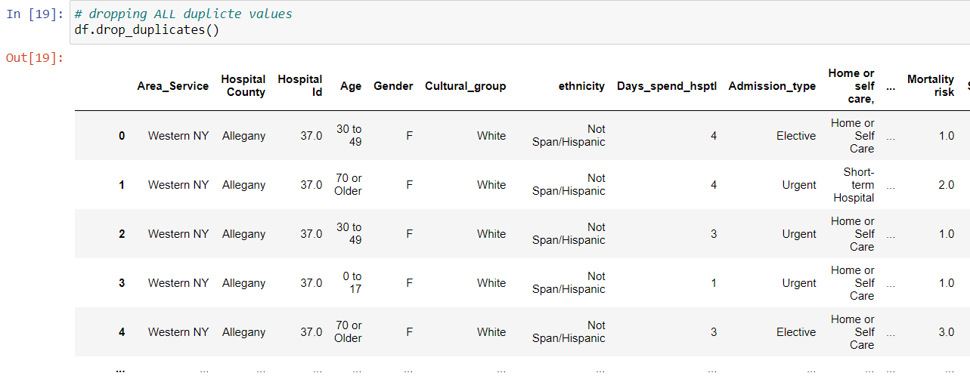
Droping duplicates values
Dropping all duplicate values-

Slide 26
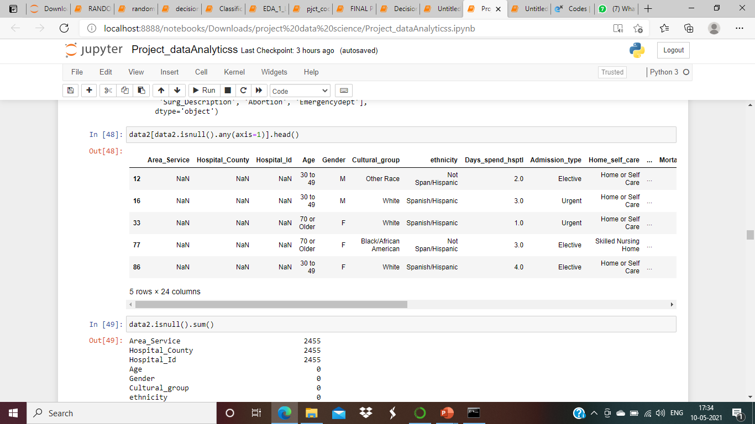
Finding null values from the dataset

Slide 27
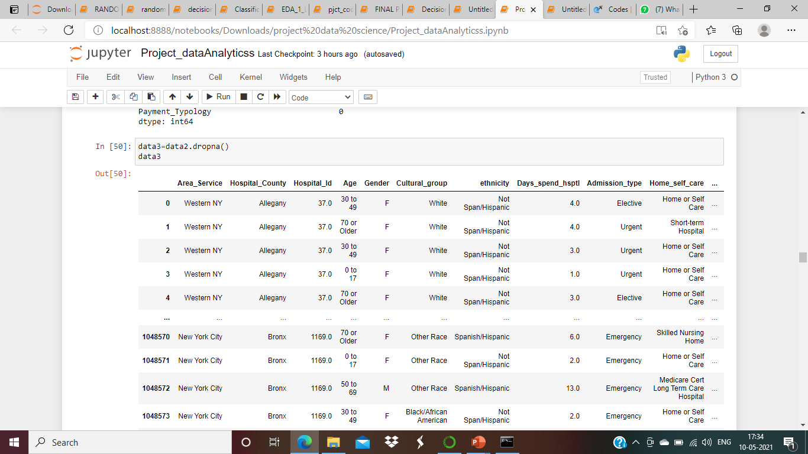
Null values drop
Insights-
We have dropped null values in dataset.

Slide 28
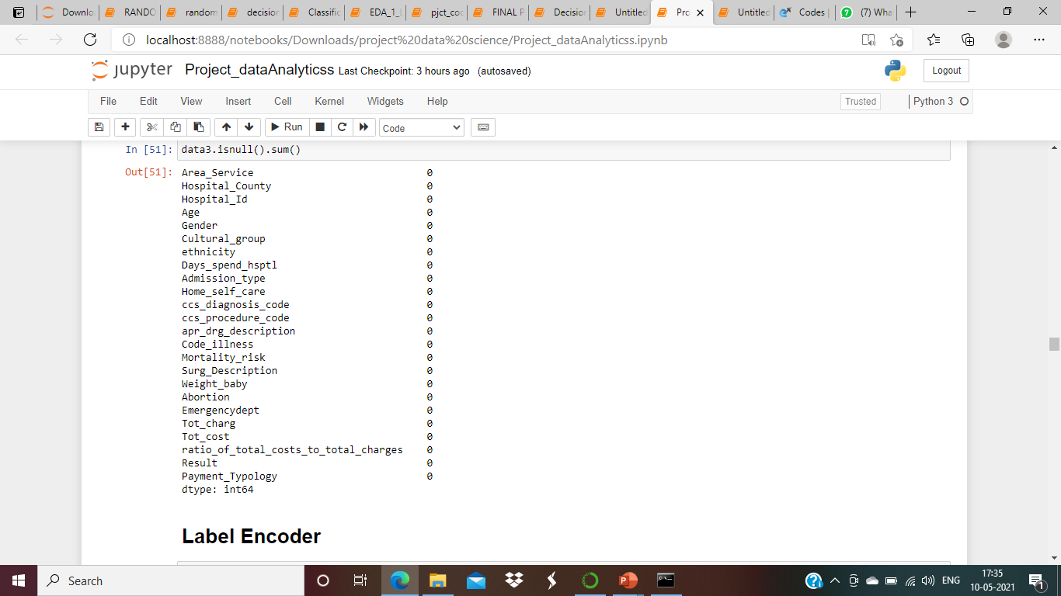
Insights-
As we can see there is no null values present in data after droping null values

Slide 29
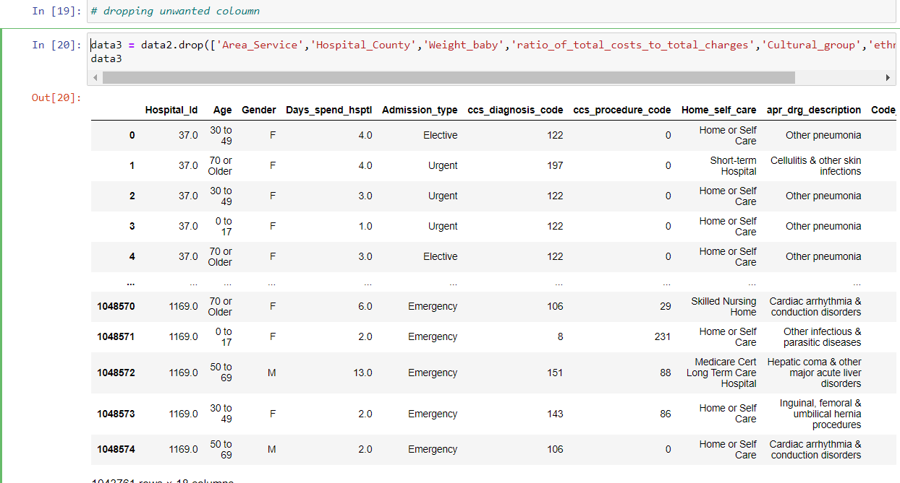
Dropping unwanted columns
Insights –
We are dropping unwanted columns
Like Area_Service','Hospital_County','Weight_baby','ratio_of_total_costs_to_total_charges‘,cultural_group and ethnicity will not effect your claiming

Slide 30
Hospital County - since irrespective of which hospital it is there will be claims if a person having mediacl emergency is being treated so we delete these coloumns.
Weight_baby - Wherever the admission type is “New Born”, there will be some baby weight, otherwise it is 0. since 90% of the rows are 0 we can eliminate wbaby weight.
ratio_of_total_costs_to_total_charges - It just indicates whether the hospital is making profit or not

Slide 31
Visualizations
Python
Basic visualizations
Stacked histogram
Visualizations (Description) -
1. Visualizations using Pandas Profiling (Python)
Basic visualizations on attributes
Stacked histogram (Input parameters Vs Output parameter [Result])

Slide 32
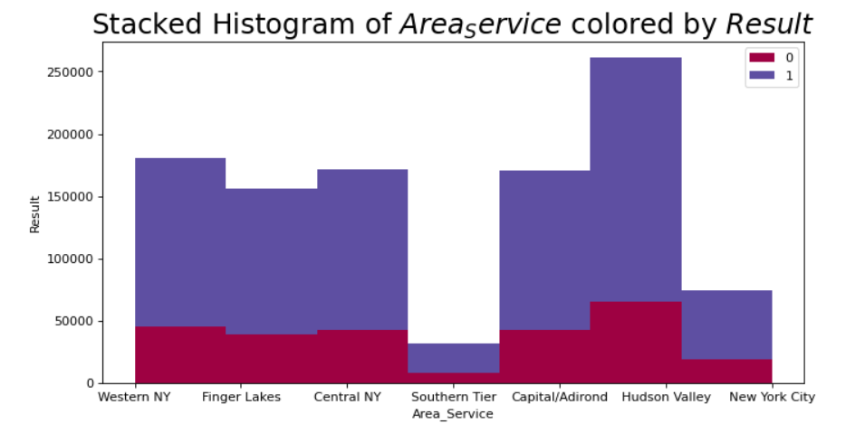
Area Service
Insights –
We are comparing result with Area services .
Hudson valley has highest claim for fraud and genuine
Southern Tier has lowest claim for fraud and genuine
Central NY and Adirond has same claim for fraud and genuine

Slide 33
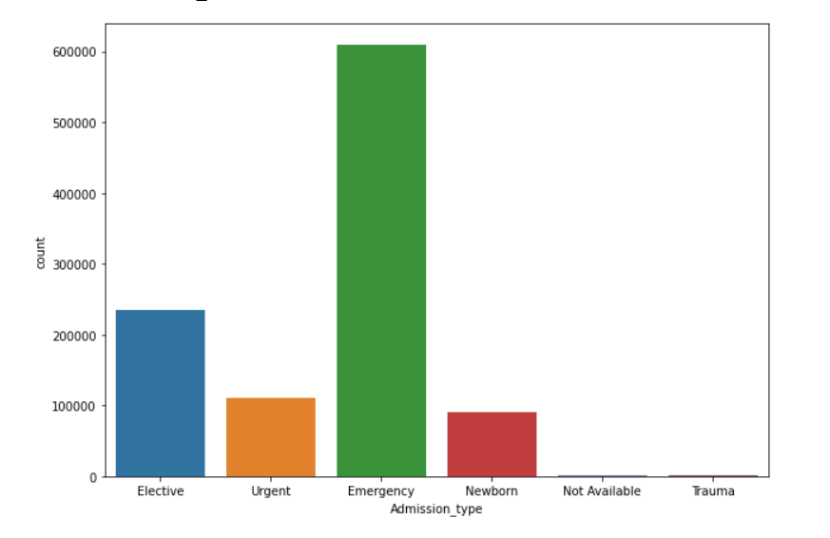
Count plot showing Admission type
Insights-
In admission type , Emergency has the highest number of count where as not available and trauma has the lowest count

Slide 34
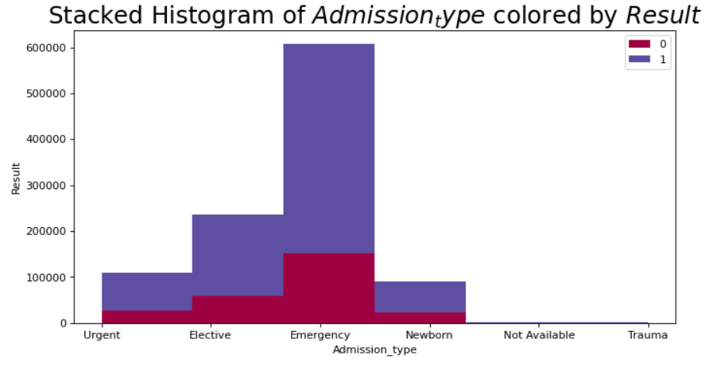
Stack Plot showing Admission type Vs Result
Insights –
We are comparing result with Admission type .
Emergency has the highest number of count for fraud and genuine where as not available and trauma has the lowest count for fraud and genuine

Slide 35
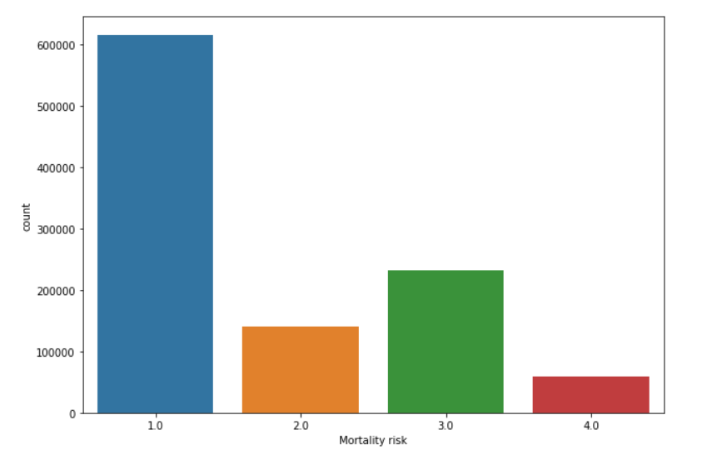
Count plot showing Mortality Risk
Insights-
In Mortility risk , 1.0 -for Minor has the highest number of count where as 4.0 -for Severe has the lowest count

Slide 36
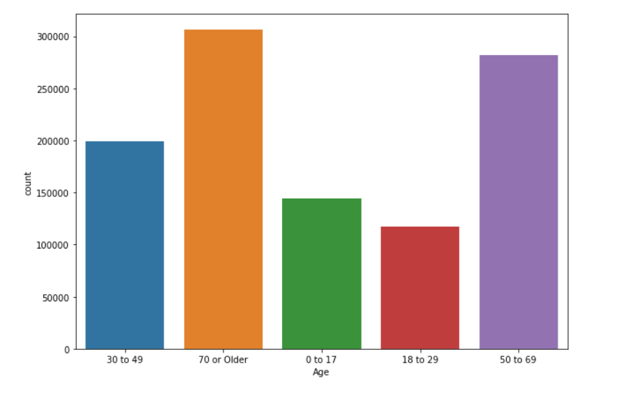
Count plot showing Age
Insights-
In Age , people who are older i.e age is more than 50 year has the highest number of count where as people whose age less than 50 year has the lowest count

Slide 37
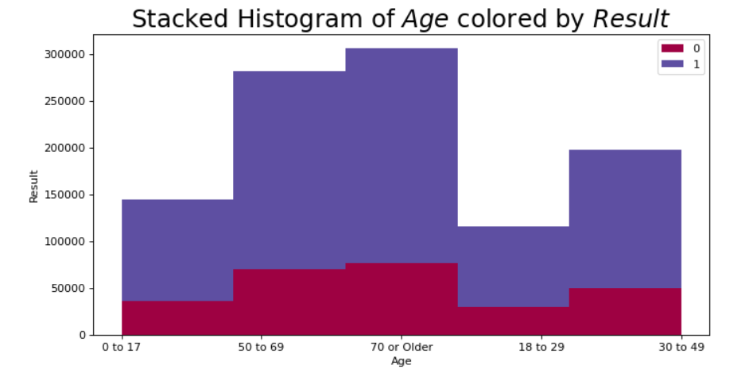
Stack Plot showing Age Vs Result
Insights-
We are comparing result with Age.
In Age , people who are older i.e age is more than 50 year has the highest number of count for fraud and genuine where as people whose age less than 50 year has the lowest count for fraud and genuine

Slide 38
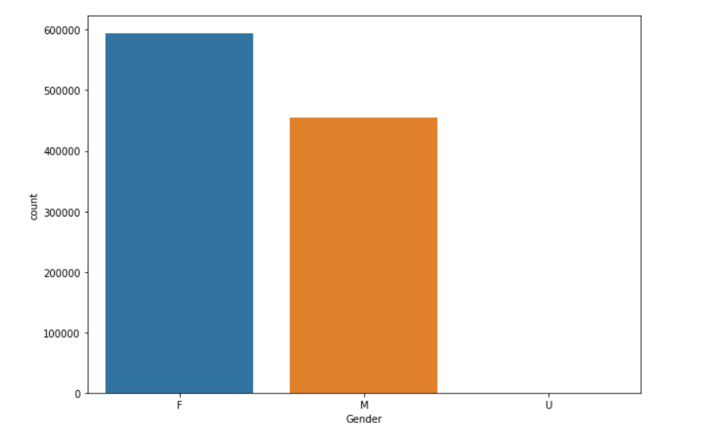
Count plot showing Gender
Insights-
In Gender , female has the highest number of count where as others has the lowest count .

Slide 39
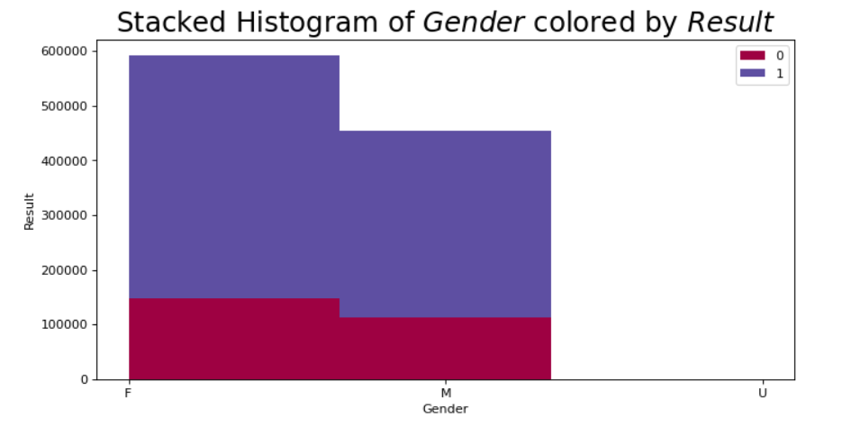
Stack Plot showing Gender Vs Result
Insights-
We are comparing result with Gender .
In Gender , female has the highest number of count for fraud and genuine where as others has the lowest count for fraud and genuine .
Compare to male , female is claiming more than male.

Slide 40
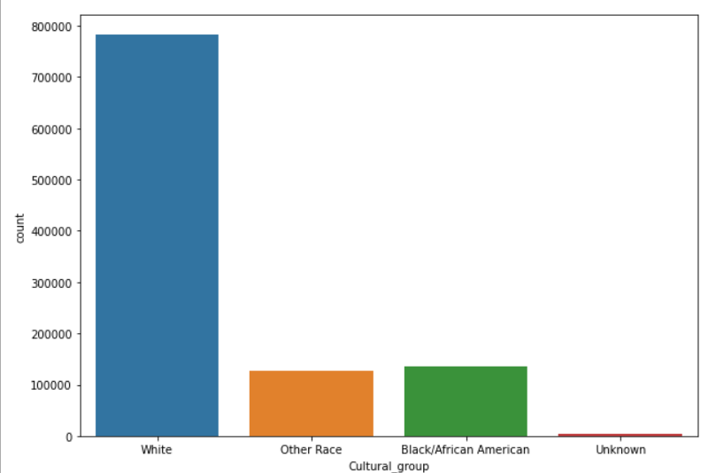
Count plot showing Cultural_group
Insights-
In Cultural_group , white has the highest number of count where as Unknown has the lowest count .

Slide 41
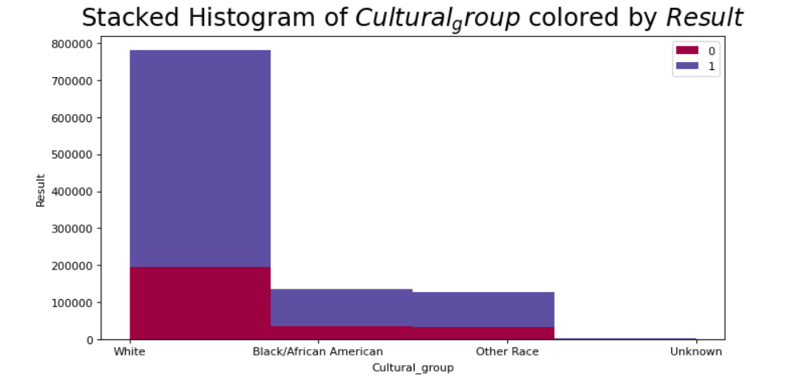
Stack Plot showing Cultural Group Vs Result
Insights-
We are comparing result with Cultural_group.
In Cultural_group , white has the highest number of count for fraud and genuine where as unknown has the lowest count for fraud and genuine .

Slide 42
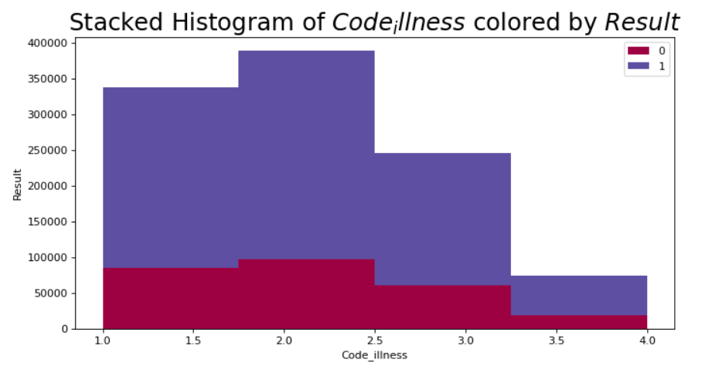
Stack Plot showing Code illness Vs Result
Insights-
We are comparing result with Code illness.
In Code illness , 2.0 -for moderate
has the highest number of count for fraud and genuine where as 4.0 -for Indeterminate has the lowest count for fraud and genuine .

Slide 43
Missing value Analysis
Missing Value Analysis
In statistics, missing data, or missing values, occur when no data value is stored for the variable in an observation. Missing data are a common occurrence and can have a significant effect on the conclusions that can be drawn from the data. So we will compute missing value for all the columns.

Slide 44
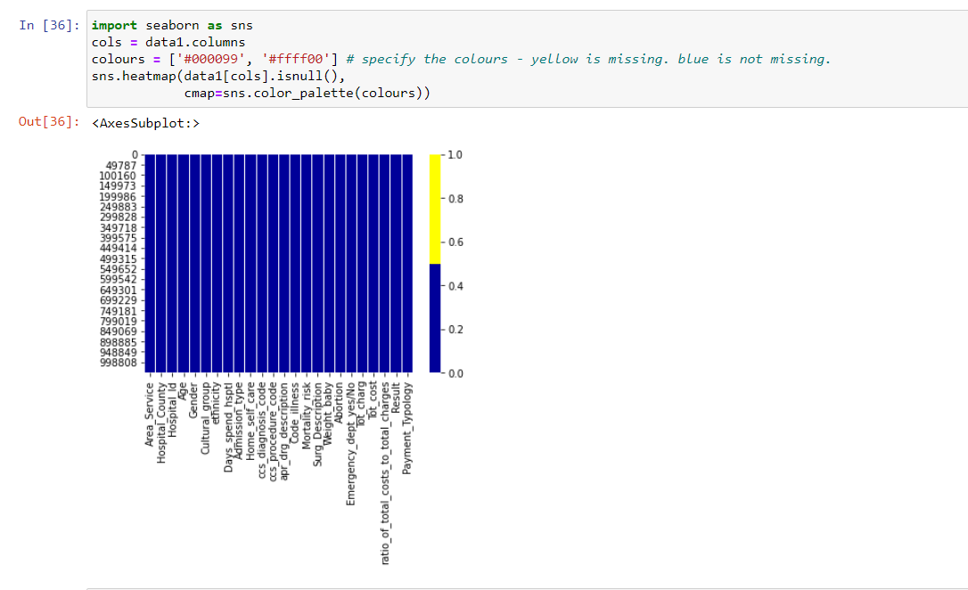
Insights -
We can say that heatmap shows their is no missing values in the data set

Slide 45
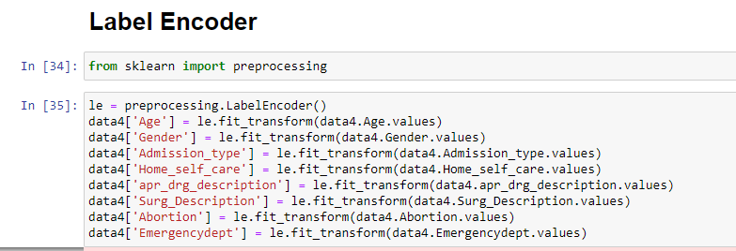
Label Encoder
In label encoding , we replace the categorical value with a numeric value.
As machine learning algorithm only work on numeric values .
these variable are categorical value. eg-'Age', 'Gender', 'Admission_type', 'Home_self_care', 'apr_drg_description', 'Surg_Description', 'Abortion', 'Emergencydept .

Slide 46
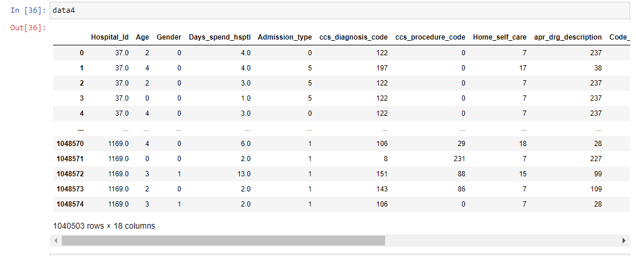

Slide 47
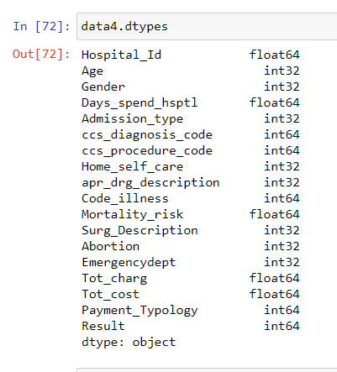
'
Insights-
As you can see all the variables are now in numeric form

Slide 48
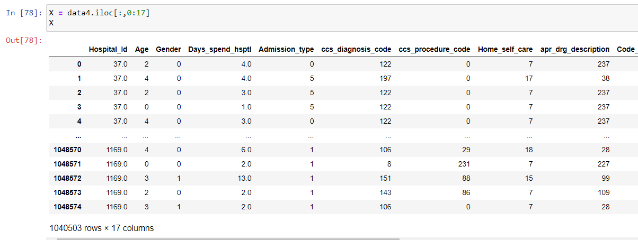
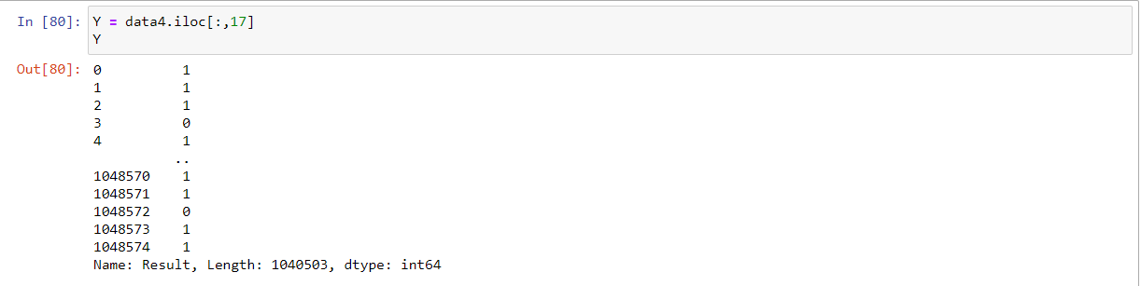
Insights-
We are splitting dependent and independent values
So here X is dependent and y is independent ie y is Result

Slide 49
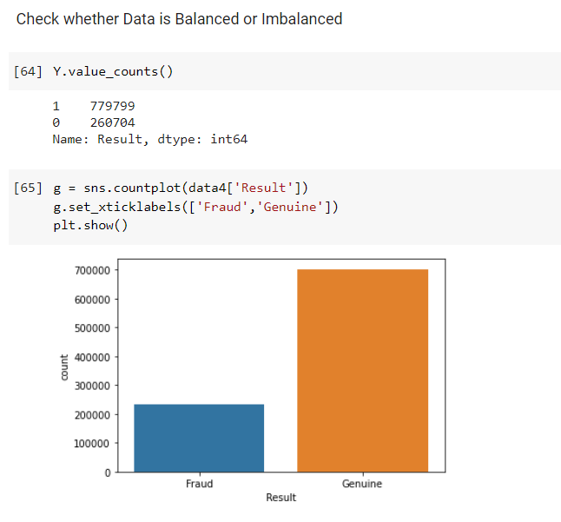
Balanced or Imbalanced Data
Insights-
As we can see that our data is not balanced ie we will not get accurate results so we are using smotet to balanced the data

Slide 50
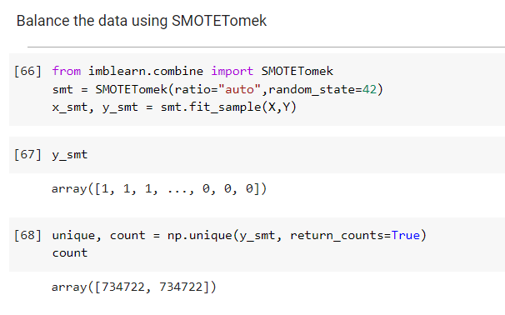
Using Smotet method for oversampling
Insights-
We are using “SMOTETomek “ method to balance the data.

Slide 51
Model accuracy
model | training_score | testing_score
LogisticRegression | 51% | 51%
KNeighborsClassifier | 99% | 81%
DecisionTreeClassifier( Entropy) | 80% | 80%
BaggingClassifier | 81% | 81%
AdaBoostClassifier | 86 % | 81%
XGBClassifier | 82% | 81%
RandomForestClassifier | 86% | 83%
GradientBoostingClassifier | 81% | 81%

Slide 52
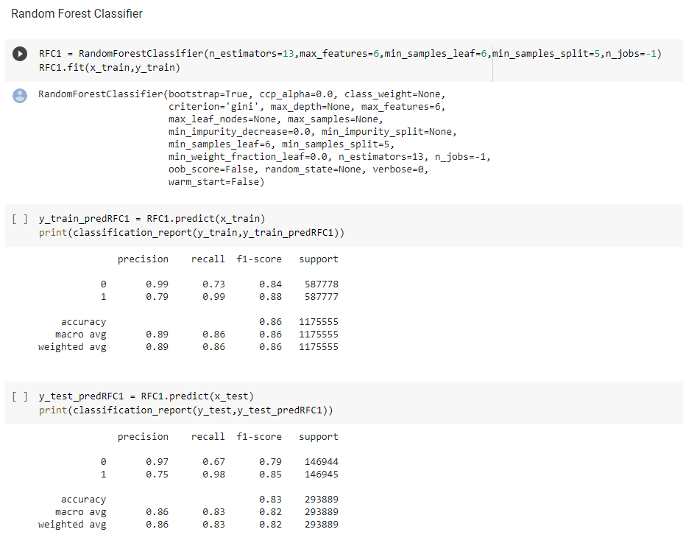
Insights-
We have done different model building algorithm and from that we get insights like accuracy , precision and F1 score
RandomForestClassifier gives the best result out of different ML algorithm with an accuracy of 86% . But the model has overfitting situation
We are getting train accuracy as 86% and test accuracy as 83%

Slide 53
Model accuracy with hyperparameter tuning
model | training_score | testing_score
LogisticRegression | 51% | 51%
KNeighborsClassifier | 99% | 81%
DecisionTreeClassifier( Entropy) | 81% | 81%
BaggingClassifier | 81% | 82%
AdaBoostClassifier | 85 % | 81%
XGBClassifier | 82% | 83%
RandomForestClassifier | 85% | 83%
GradientBoostingClassifier | 80% | 80%

Slide 54
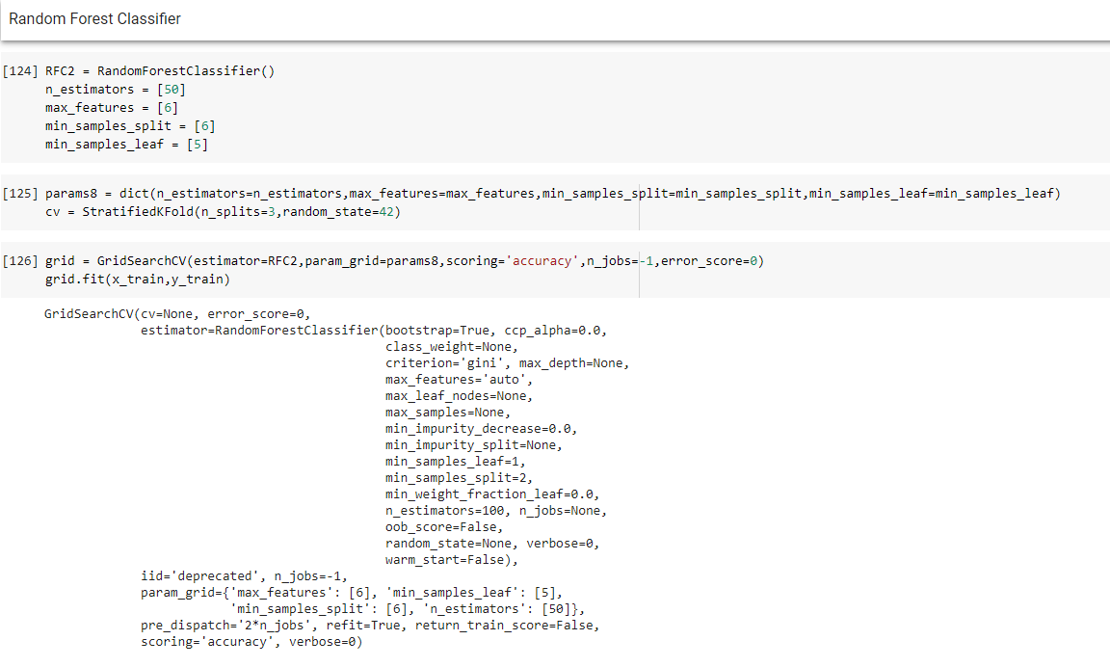
Insights-
We are using grid search hyperparameter tuning to overcome or to reduce overfitting situation
RandomForestClassifier gives the best result out of different ML algorithm with an accuracy of 85% .
After hyperparameter tuning , We are getting train accuracy as 82% and test accuracy as 83%
So we have 2% of overfitting in a model

Slide 55
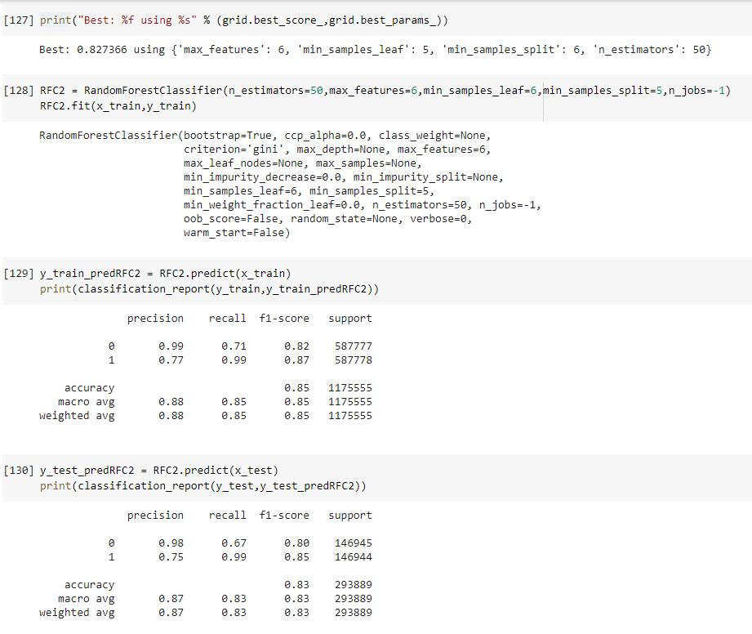
Insights-
We are using best grid parameter to get the accuracy , recall score , f1 score and precision to get the best output result for model .

Slide 56
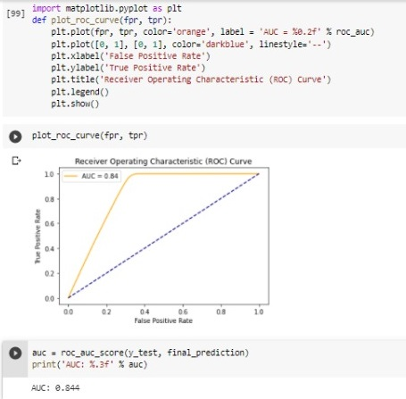
ROC Curve and ROC score
Insights-
The ROC curve is simply a graphical plot of the relationship between the False Positive Rate (FPR) and the True Positive Rate (TPR) when the discrimination threshold of a classifier is varied.
An AUC which is close to 1 is quite often considered to be the model being good

Slide 57
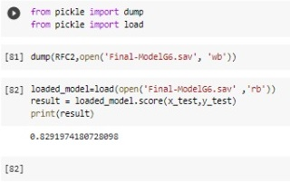
Saving the model for deployment
Insights-
We are using pickle to dump and load the model for deployment
Saving the model by name as “Final-Model.sav”.
We are getting 82.9 % accuracy for loaded model

Slide 58
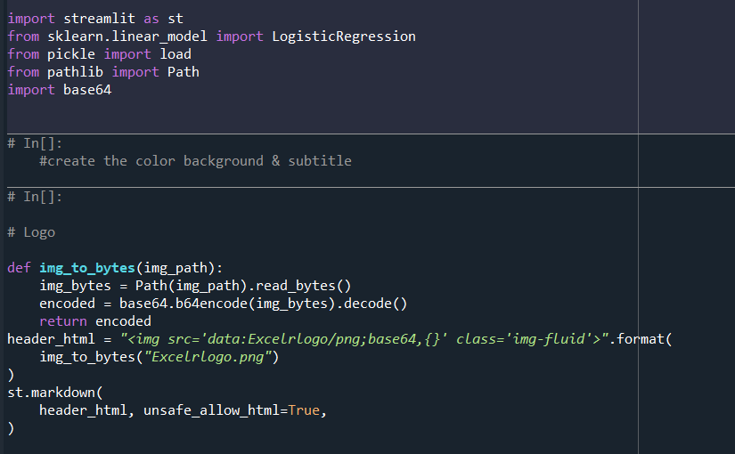
Deployment of model
Insights-
Importing the required libraries like streamlit , pickle, pathlib, base 64
We are using this code for uploading “ExcelR “ logo in localhost web page.

Slide 59
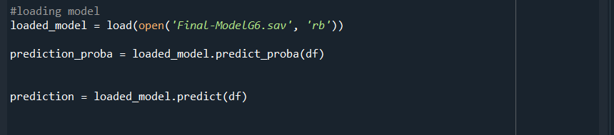
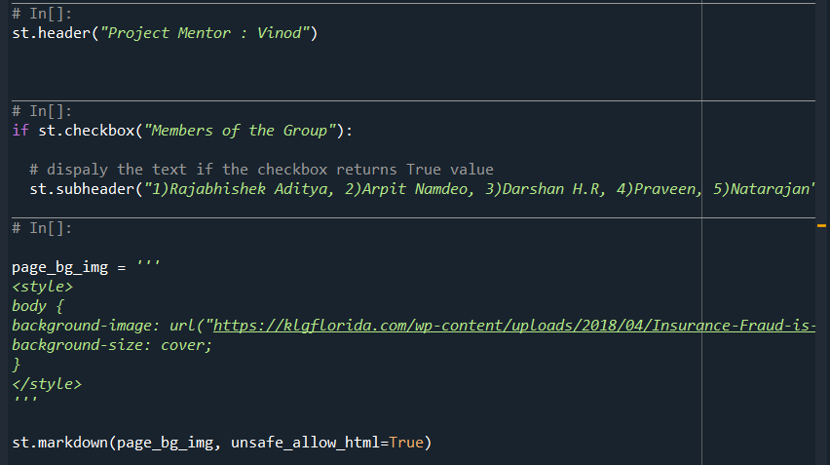
Insights-
Loading the model.
We are adding project mentor and member of group names in webpage.
Adding background image in webapage .

Slide 60
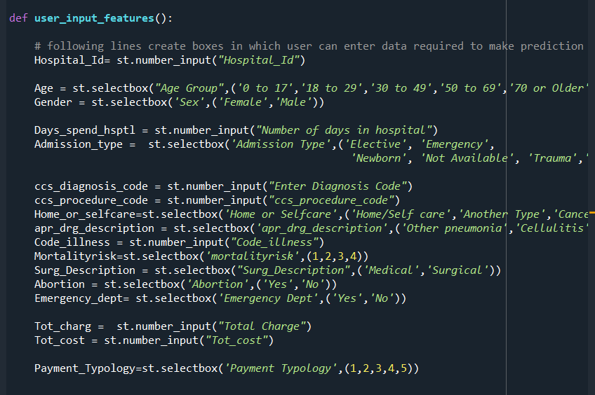
Insights-
Here we are predicting our model with 17 features

Slide 61
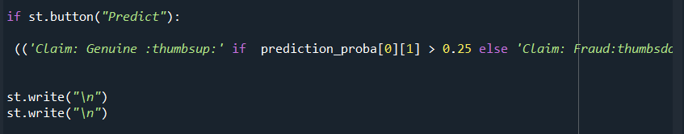
Insights-
When 'Predict' is clicked and it will make the prediction and store it

Slide 62

View of deployment page

Slide 63
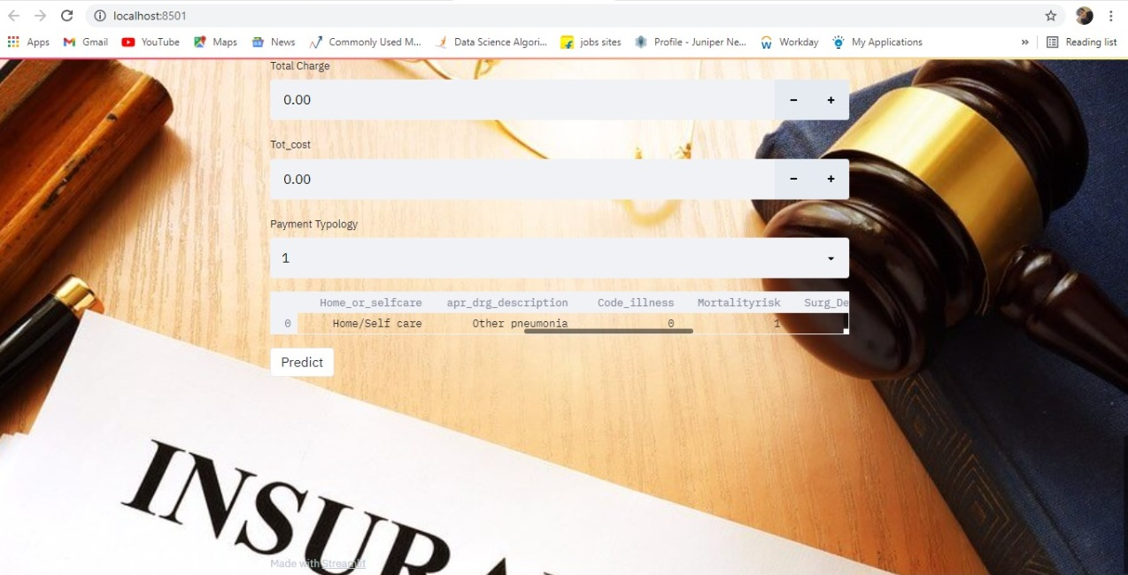

Slide 64
Thank you

